Slide 1
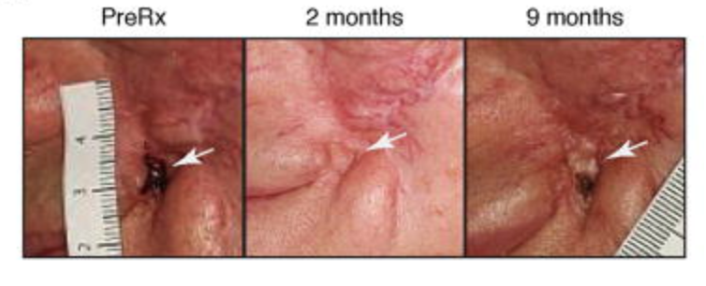
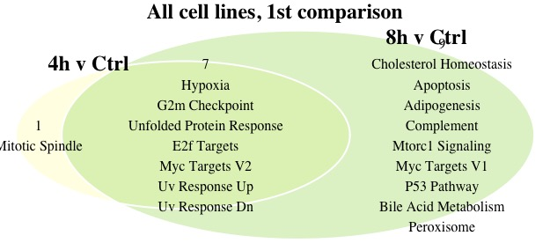
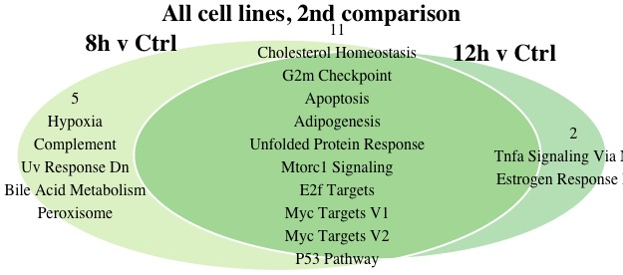
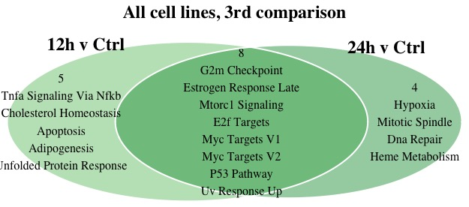
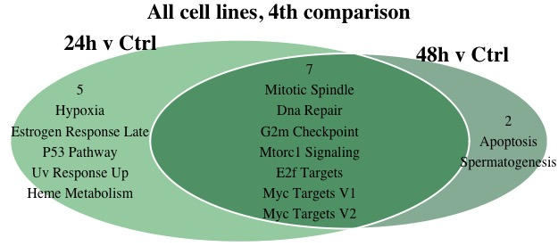
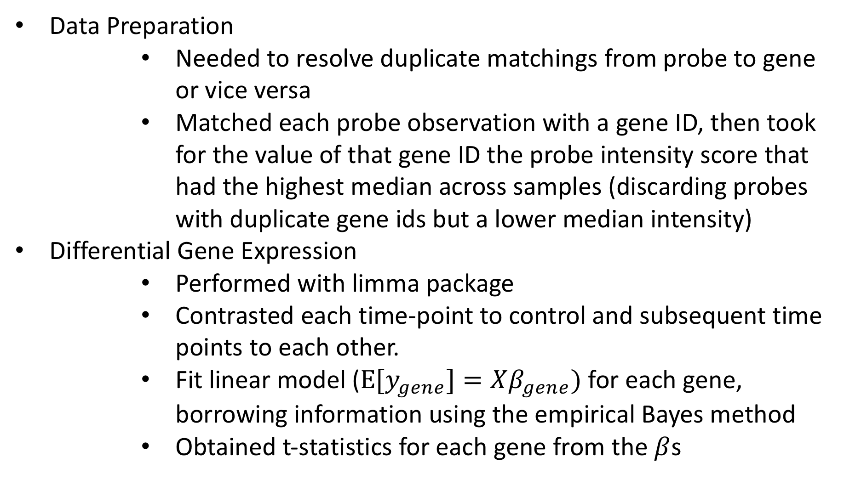
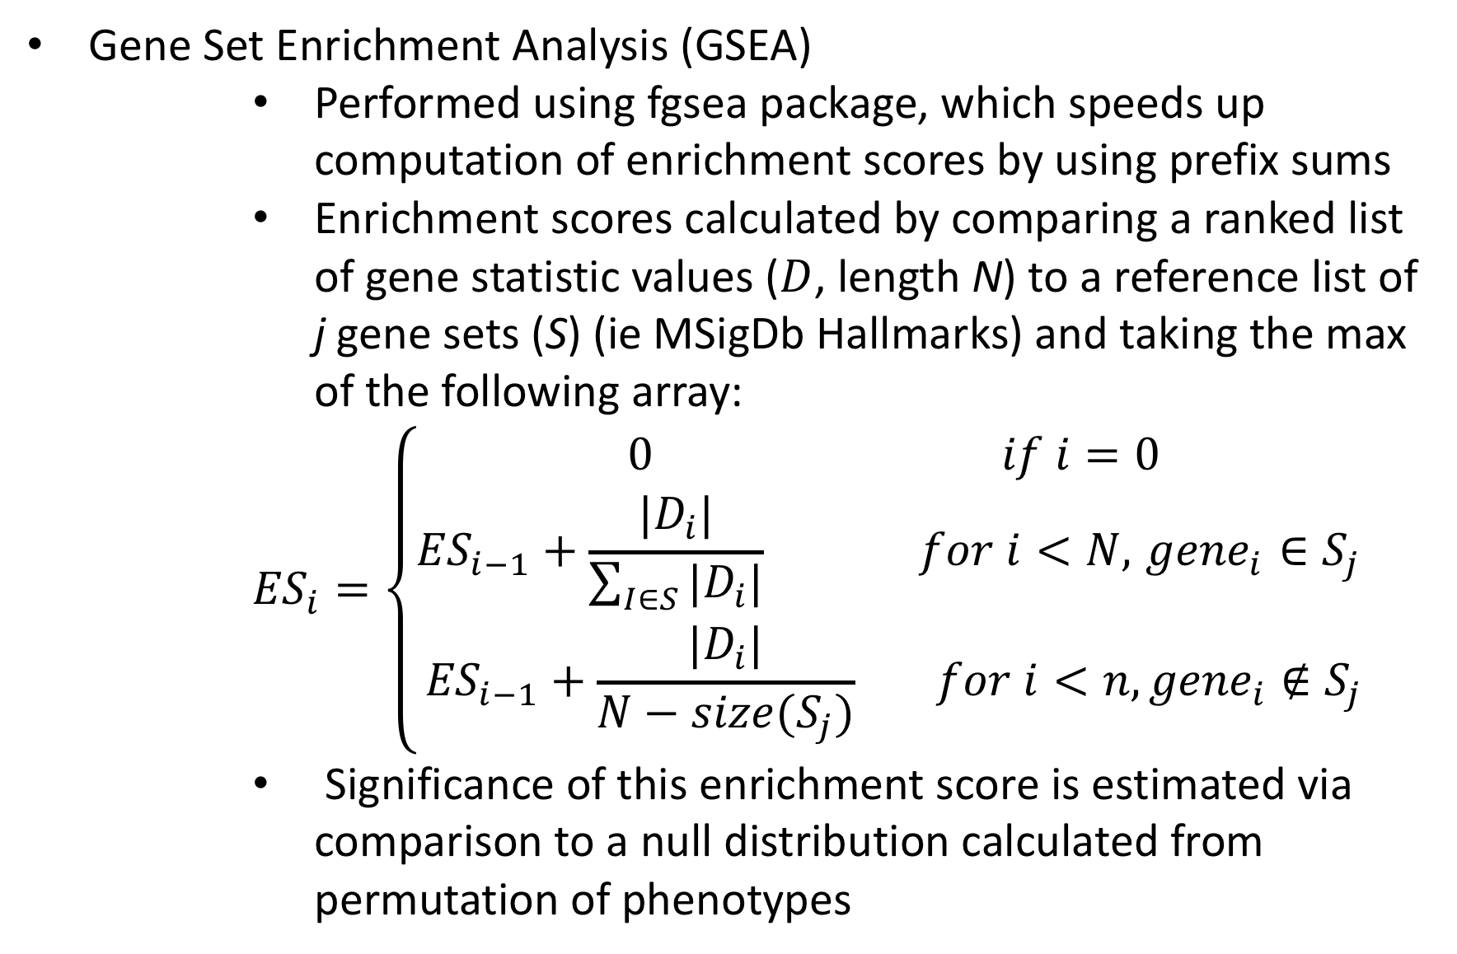
Evolution of Drug Resistance: Gene Set Enrichment Analysis of Breast Cancer Cells Treated with a PI3K⍺ Inhibitor Ruby Fore, Lorin Crawford, PhD
BROWN
School of Public Health
Abstract
Results
New pathway inhibitor treatments have a demonstrated ability to reverse the spread of cancer in an individual patient, but resistance to drug frequently develops. A better understanding of what existing pathways are upregulated to account for the loss of the inhibited pathway is an important first step in designing treatments for more permanent remission. In this project I used a publicly available dataset to investigate which pathways were enriched as treatment progressed over time.
Fig 5. A Baal cell carcinoma (different cancer, different mutation) treated with a similar inhibitor. Cancer originally disappears, but then resistance develops. (Sharpe, et al. 2015)
Discussion
Background
As seen in Table 1, there were fewer differentially expressed genes in comparison between subsequent timepoints than there were in the timepoint-control comparisons. As time passed, the number of differentially expressed genes increased dramatically in the timepoint to control comparison.
In analyses of individual cell lines, the overlap in enriched pathways between two subsequent time points compared to control was greater than the overlap between the first and final timepoints.
Pathways enriched in all timepoints as compared to control are pathways known to be associated with cancer, such as MYC targets, MTOR signaling and E2F targets.
The original Bosch et al. paper determined that estrogen receptor activity was heightened in cancer cell lines with PI3K⍺ mutations treated with BYL719 (a PI3K⍺ inhibitor). The portion of the data I used consisted of sequencing data for 3 cell lines, two with the PI3K⍺ mutation and one with a downstream mutation. Samples of cancer cell lines were treated with BYL719 up until a time cutoff and the resulting cell culture was sequenced in triplicate.
Methods
Data Preparation
Needed to resolve duplicate matchings from probe to gene or vice versa
Matched each probe observation with a gene ID, then took for the value of that gene ID the probe intensity score that had the highest median across samples (discarding probes with duplicate gene ids but a lower median intensity)
Differential Gene Expression
Performed with limma package
Contrasted each time-point to control and subsequent time points to each other.
Fit linear model ($E[y_{gene}]=Xβ_{gene})$ for each gene, borrowing information using the empirical Bayes method
Obtained t-statistics for each gene from the $β$s
Conclusion
Results demonstrate that resistance to treatment evolves over time, with final resistant state at 48 hours having the most (208) differentially expressed genes of any time point. Resistance relies on the upregulation of multiple pathways, already known to be linked with cancer.
Limitations: Only incorporates data from a single study – may want to repeat the analysis with other studies with the same cell lines.
Gene Set Enrichment Analysis (GSEA)
Performed using fgsea package, which speeds up computation of enrichment scores by using prefix sums
Enrichment scores calculated by comparing a ranked list of gene statistic values ($D$, length N) to a reference list of j gene sets (S) (ie MSigDb Hallmarks) and taking the max of the following array:
$${ES}_{i}=\left\{\begin{aligned}0 if i=0 \\ {ES}_{i−1}+\frac{{|D}_{i}|}{\sum_{I∈S}{{|D}_{i}|}} for i<N, { gene}_{i} ∈S_{j} \\ {ES}_{i−1}+\frac{{|D}_{i}|}{N−size(S_{j})} for i<n, {gene}_{i}∉S_{j}\end{aligned}\right.$$
Significance of this enrichment score is estimated via comparison to a null distribution calculated from permutation of phenotypes
Bibliography
Figs 1-4. Overlapping and distinct enriched gene pathways between time points.
Ritchie, M. E., Phipson, B., Wu, D., Hu, Y., Law, C. W., Shi, W., & Smyth, G. K. (2015). limma powers differential expression analyses for RNA-sequencing and microarray studies. Nucleic Acids Research, 43(7), e47–e47. https://doi.org/10.1093/nar/gkv007
Sergushichev, A. (2016). An algorithm for fast preranked gene set enrichment analysis using cumulative statistic calculation. BioRxiv, 060012. https://doi.org/10.1101/060012
Sharpe, H. J., Pau, G., Dijkgraaf, G. J., Basset-Seguin, N., Modrusan, Z., Januario, T., … de Sauvage, F. J. (2015). Genomic Analysis of Smoothened Inhibitor Resistance in Basal Cell Carcinoma. Cancer Cell, 27(3), 327–341. https://doi.org/10.1016/j.ccell.2015.02.001
Subramanian, A., Tamayo, P., Mootha, V. K., Mukherjee, S., Ebert, B. L., Gillette, M. A., … Mesirov, J. P. (2005). Gene set enrichment analysis: a knowledge-based approach for interpreting genome-wide expression profiles. Proceedings of the National Academy of Sciences of the United States of America, 102(43), 15545–15550. https://doi.org/10.1073/pnas.0506580102
Time point | To previous time | To control
4 hours | 4 genes | 4 genes
8 hours | 0 | 19
12 hours | 0 | 28
24 hours | 12 | 106
48 hours | 0 | 208
Table 1. Number of differentially expressed genes at each comparison, FDR level of 0.05, combined across 3 cell lines.

